Slide 1
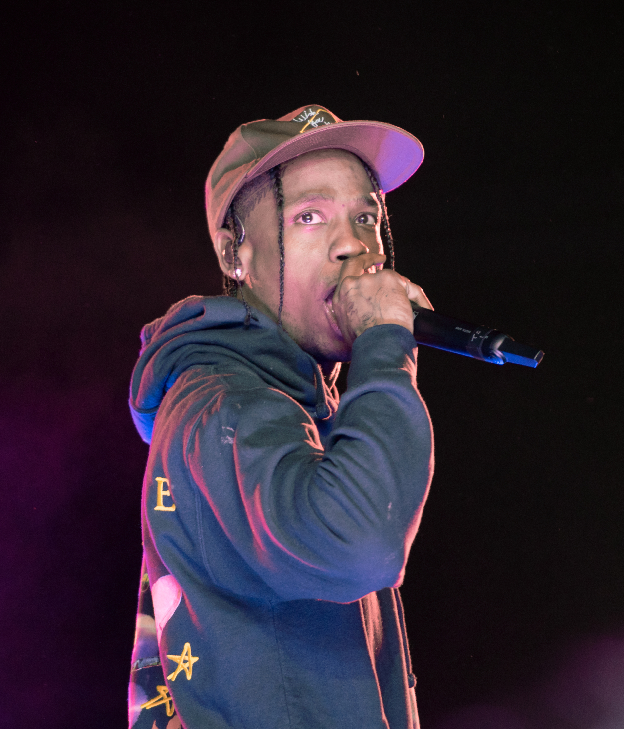

Travis Scott

Slide 2
About Travis Scott
Travis Scott’s real name is Jacques Webster
Travis Scott dropped out of college to pursue music
Was discovered by Kanye West
Has a child named Stormi with Kylie Jenner

Slide 3
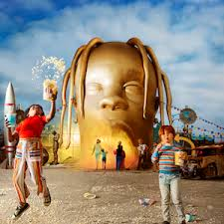
Astroworld
Track list:
STARGAZING – 4:31
CAROSEL (Ft. Frank Ocean) – 3:00
SICKOMODE (Ft. Drake, Swae Lee, Big Hawk) – 5:13
R.I.P. SCREW (Ft. Swae Lee) – 3:06
STOP TRYING TO BE GOD (Ft. Stevie Wonder, Kid Cudi, James Blake, Philip Bailey) – 5:39
NO BYSTANDERS (Ft. Juice Wrld, Sheck Wes) – 3:38
SKELETONS (Ft. The Weeknd, Pharrel Williams, Tame Impala) - 2:26
WAKE UP (Ft. The Weeknd) – 3:52
5% TINT – 3:16
NC-17 (Ft. 21 Savage) – 2:37
ASTROTHUNDER – 2:23
YOSEMITE (Ft. Gunna, NAV) – 2:30
CAN’T SAY (Ft. Don Toliver) - 3:19
WHO? WHAT! (Ft. Quavo, Takeoff) – 2:57
BUTTERFLY EFFECT – 3:11
HOUSTONFORNICATION – 3:38
COFFEE BEAN – 3:29

Slide 4
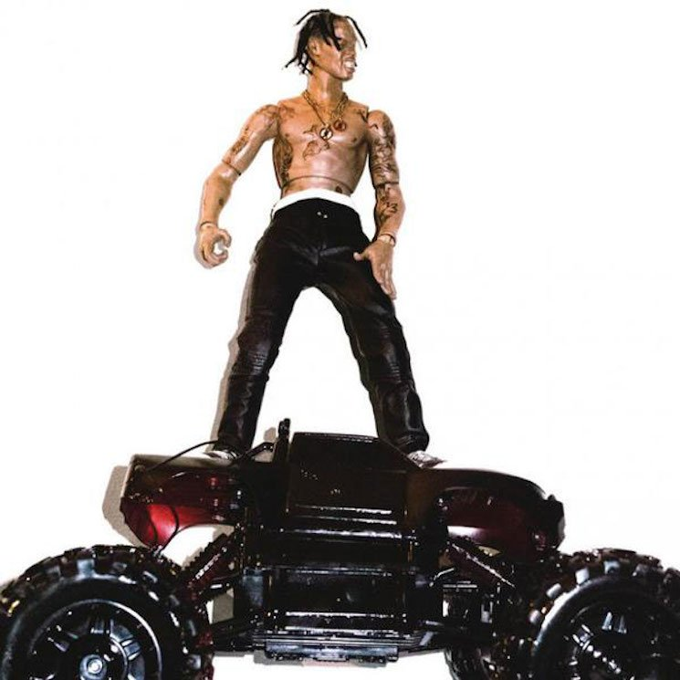
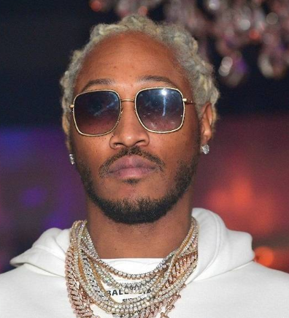



Artists like Travis Scott
Hometown
Debut Album
# of Twitter Followers
Houston, TX
7.7 Million
Atlanta, GA
6 Million
Atlanta, GA
4.6 Million

Slide 5
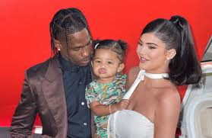
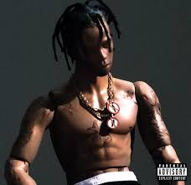
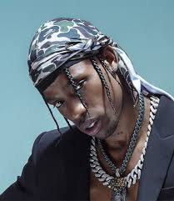
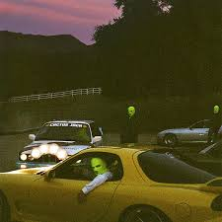
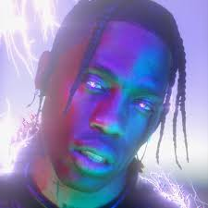
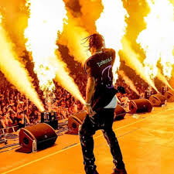
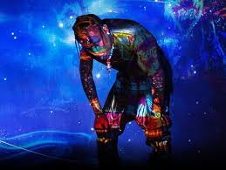
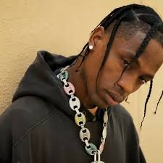
https://travisscott.com

